Slide 1

AI Initiative For Promotions Credit Notes Validation
Shaima Morgan
O2C Sales Operations SOP
Nesternship 2025

Slide 2

Agenda
Brief on the project
Requirements for implementation
Flowchart of how the app will work (technical)
How to program the AI model to extract data from documents in Power Automate
Estimated cost and time for implementation

Slide 3
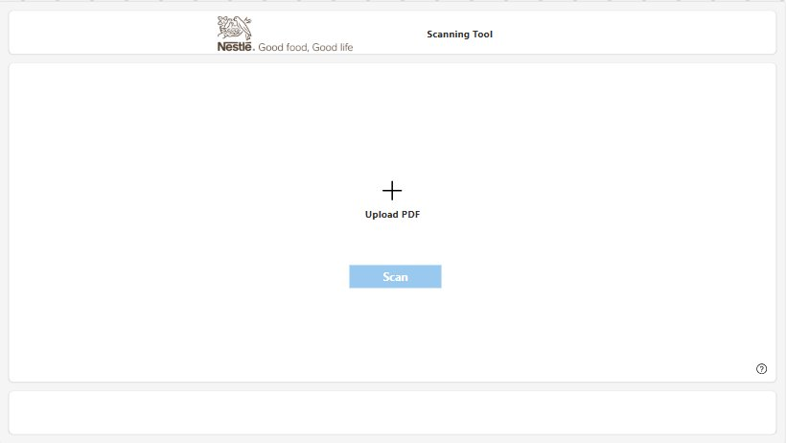
Interface (Validation App)

Slide 4
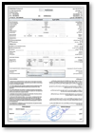
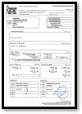
The Project (Validation App)
Press the "+" icon and upload the PDF Document. This PDF Document should include TA and Tax Invoice. Once uploaded, press the "Scan" button

Slide 5
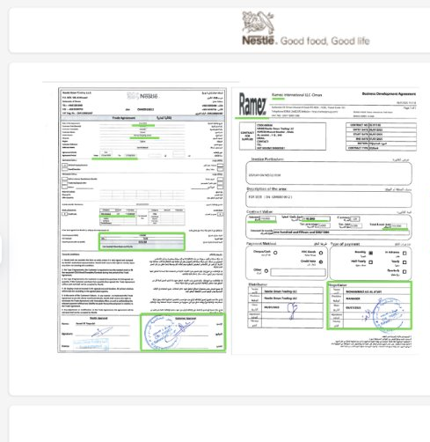
Once the validation process is done and everything is extracted from the 2-page PDF. It will appear like that, and it is valid.

Slide 6
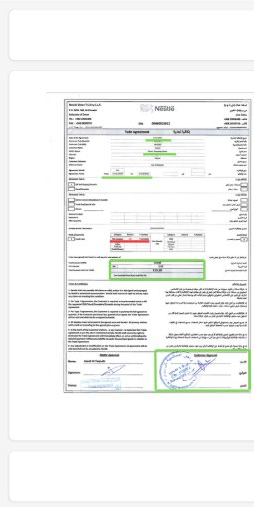
If there was any missing info in the TA or Tax Invoice. The validation app won’t be able to extract it, and it will appear like that as the results of the validation is invalid

Slide 7


Implementation Process
Required platforms to create the validation app:
Power Apps
Power Automate
Additional requirements to create the validation app:
Power Automate AI Builder Credits | Will be used for back-end of creating the validation app
Access to Environments | For Power Apps and Power Automate to allocate AI Builder Credits

Slide 8
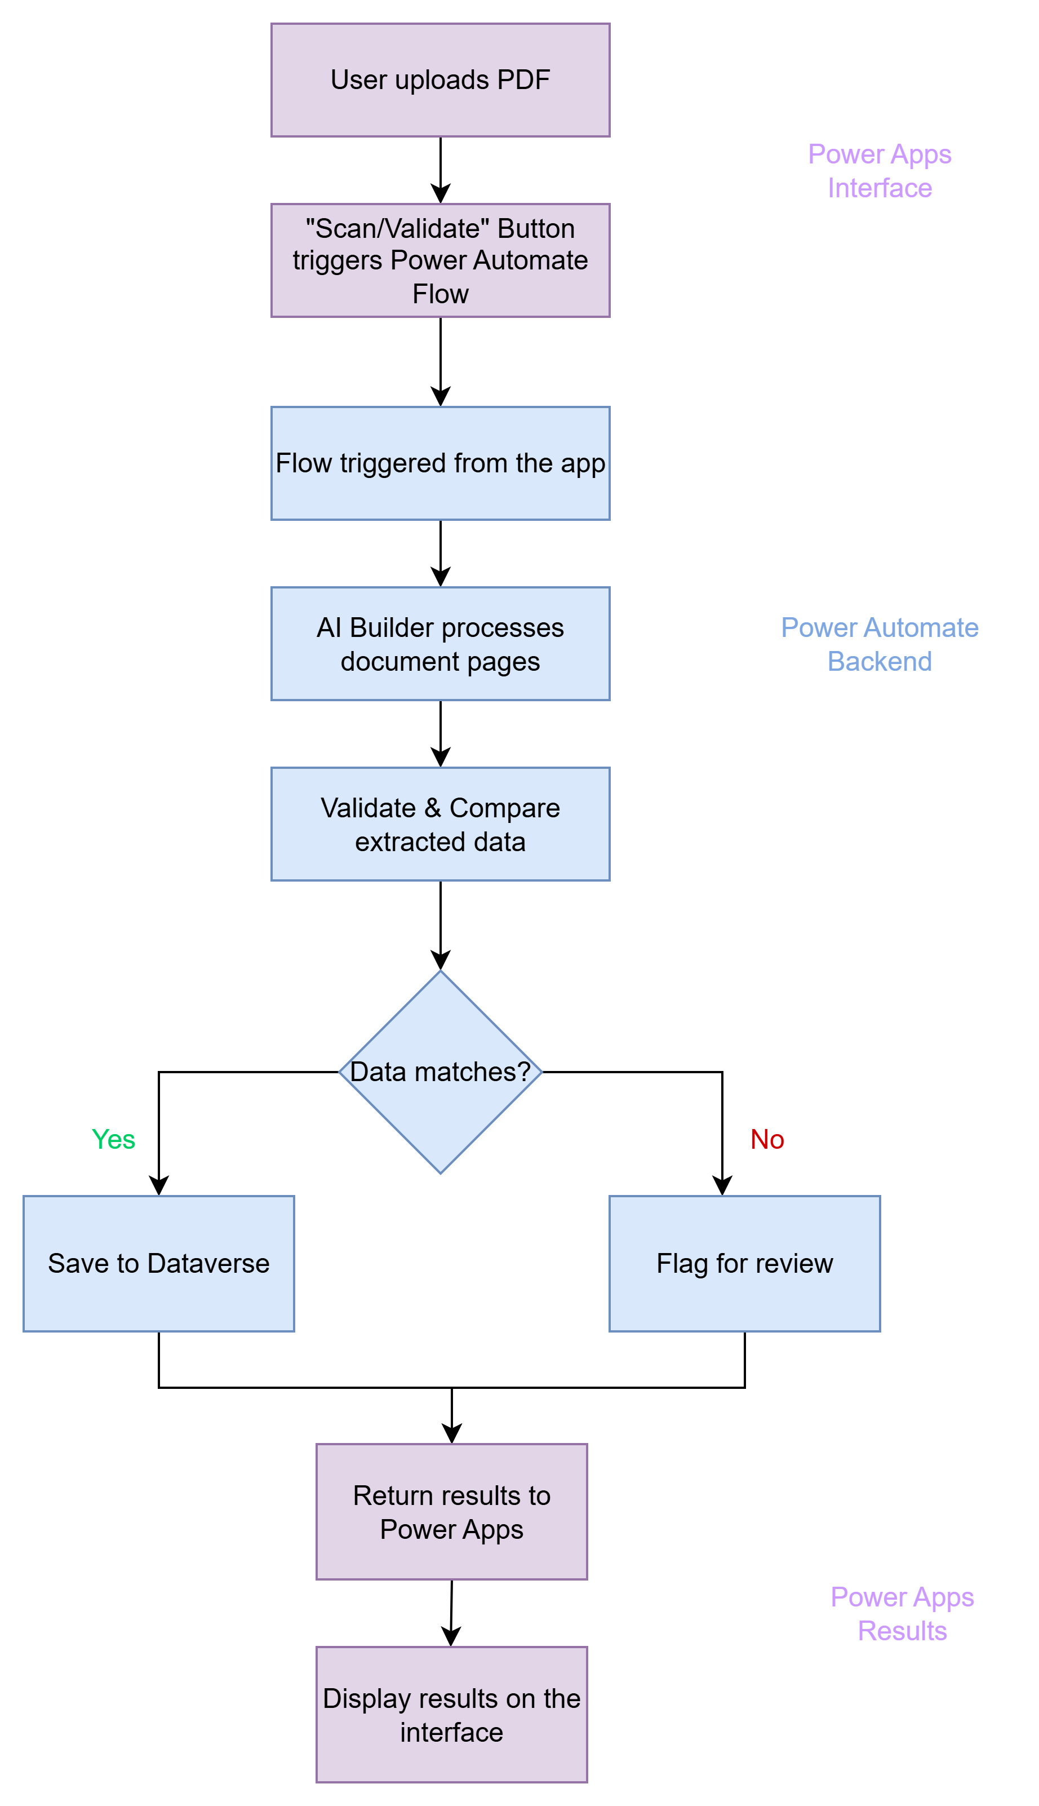

Slide 10
Dataverse will be used as a central database where Power Automate Flow can save every validation attempt including the extracted data, results and a link to the original PDF to a Dataverse table.
History of validations can be displayed in the power app by reading the Dataverse table.

Slide 11
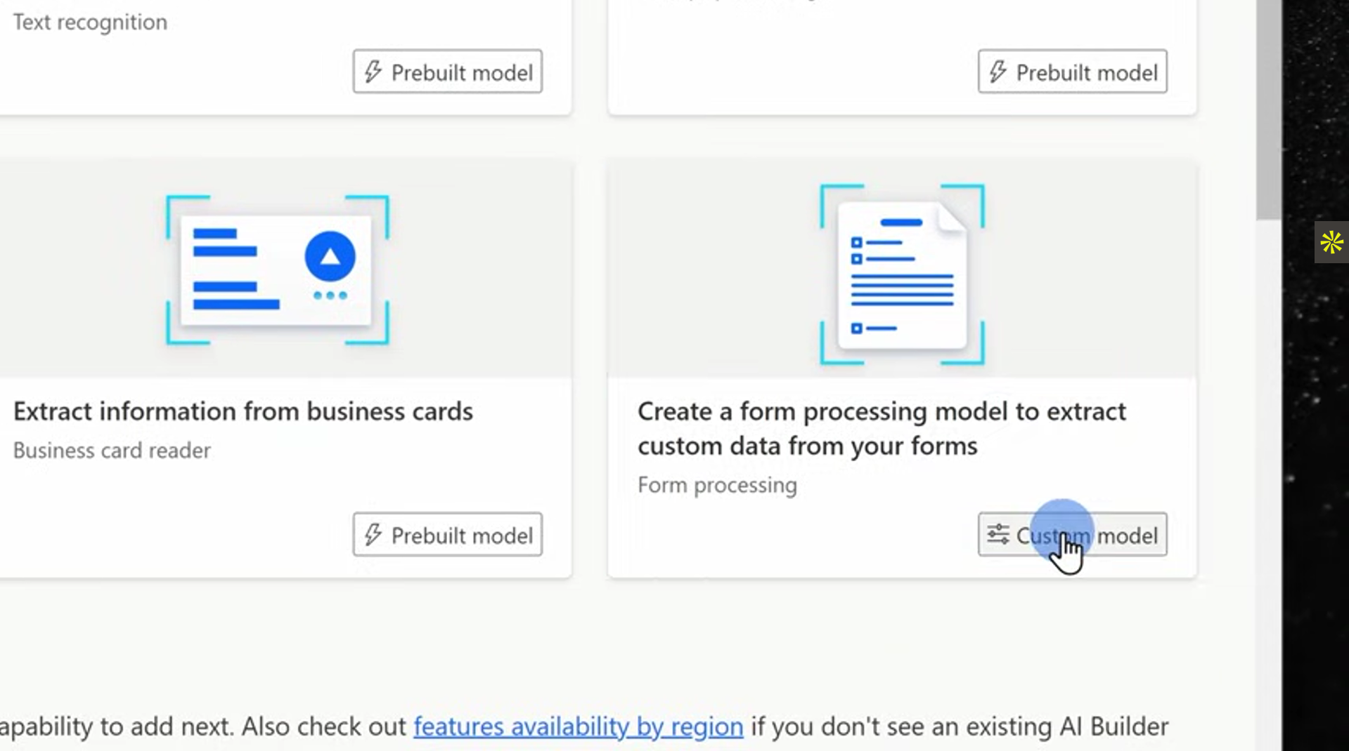
First. We will go to AI Hub then go to AI Models and choosing this type of AI Model.

Slide 12
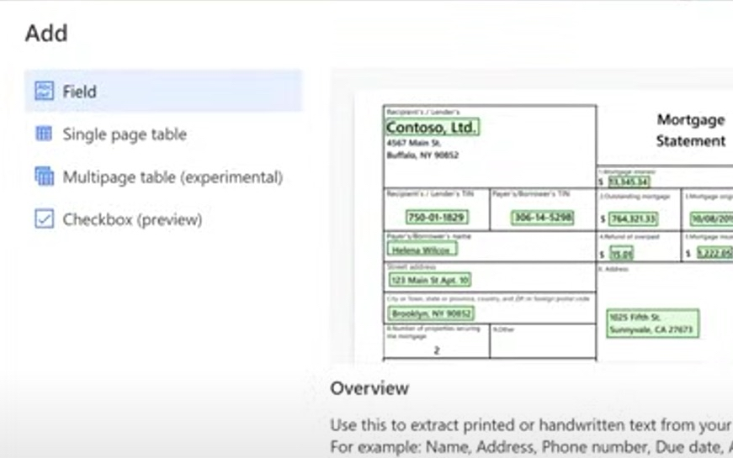
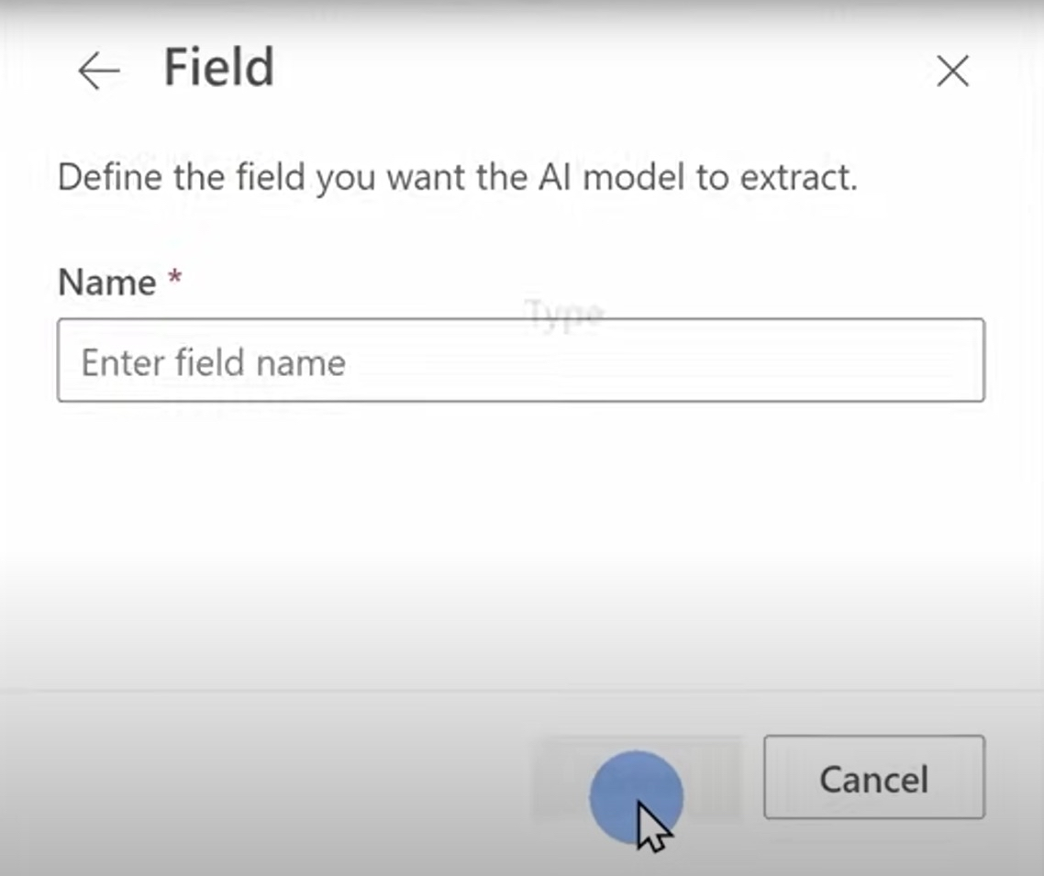
After choosing the AI Model, Press the “Add” Icon and add fields as we will specify the app what should it extract and validate from the document.

Slide 13
After specifying the fields. Name each field you have selected in here.

Slide 14
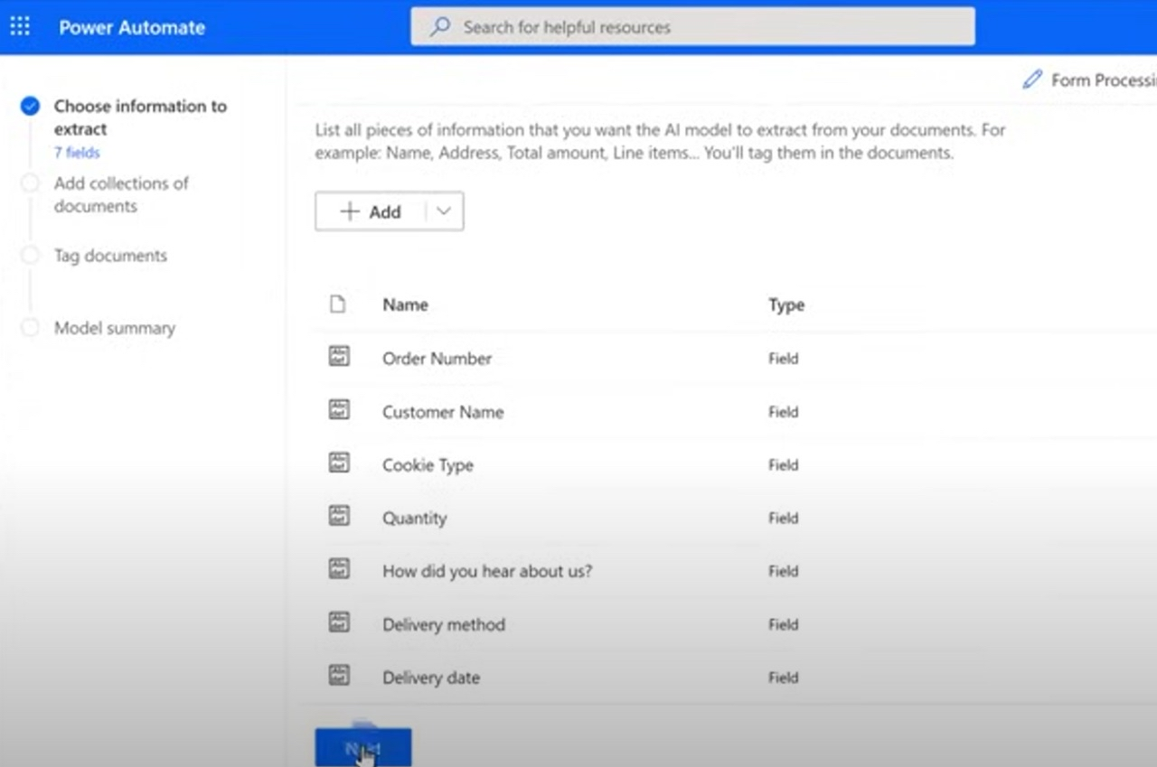
This is how it would look like after name each field.

Slide 15
Press “Next”

Slide 16
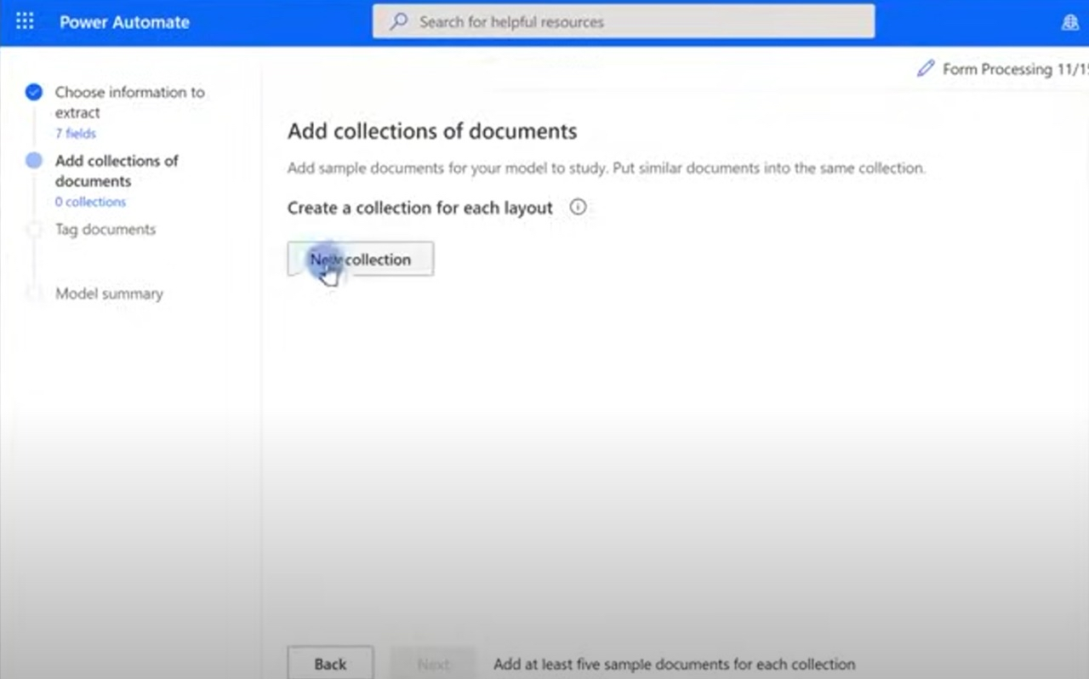
After you finish choosing the info. needed to be extracted. You must add collections for each document as each document has their own format. We will add a collection that will be mainly dedicated for Trade Agreements and add another one that will be dedicated for Tax Invoices.

Slide 17
Press “New Collection”

Slide 18
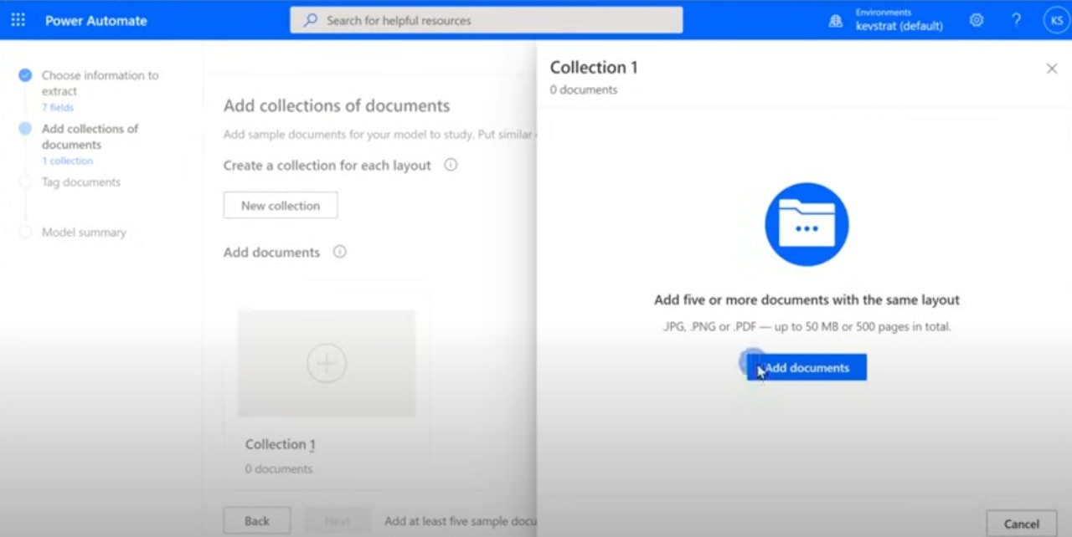

Slide 19
Add the documents that have the same layout. As each collection has their own documents.

Slide 20
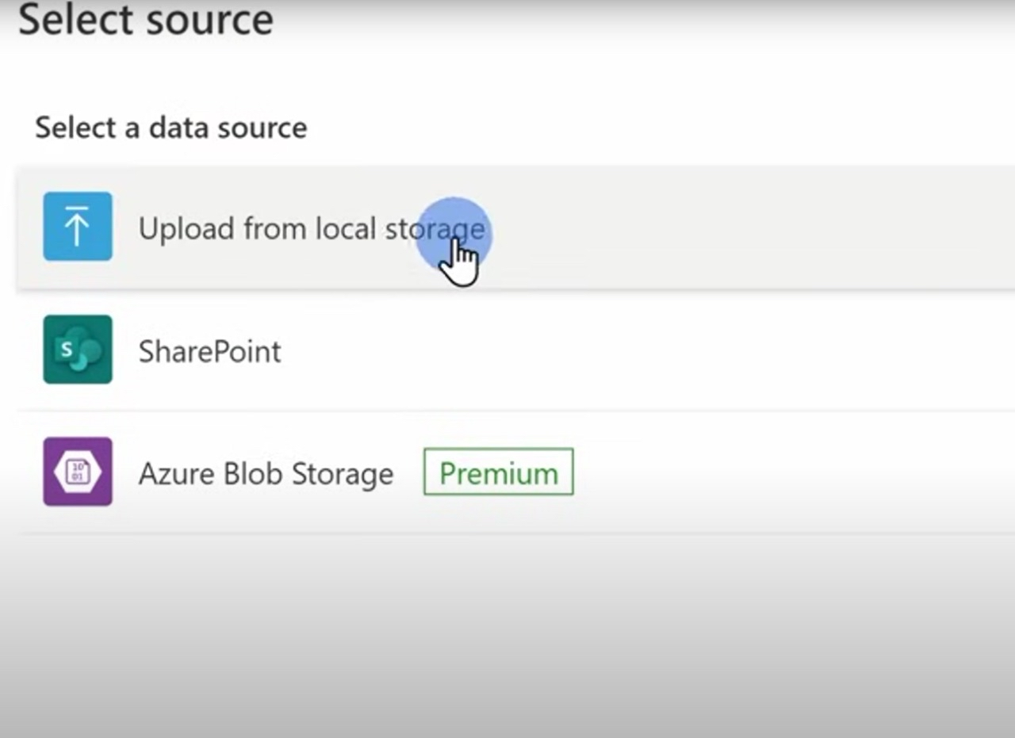
Upload the Docs from the local storage.

Slide 21
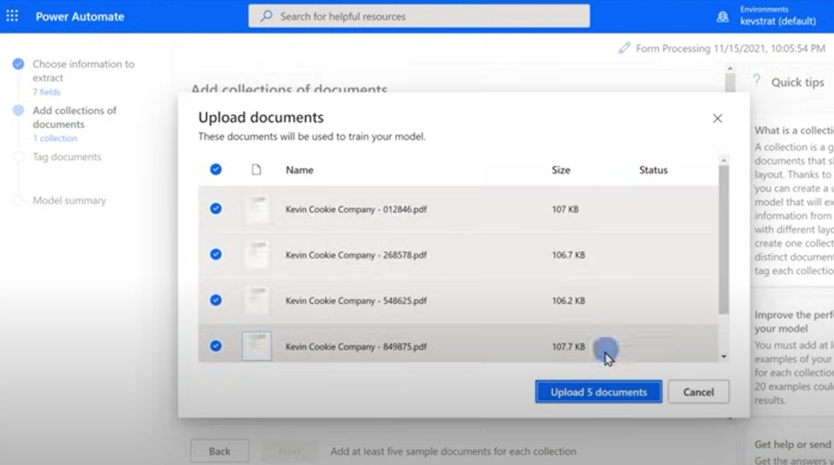

Slide 22
Upload the documents where you have added them in the collections as these will represent as samples to the AI Model for training.

Slide 23
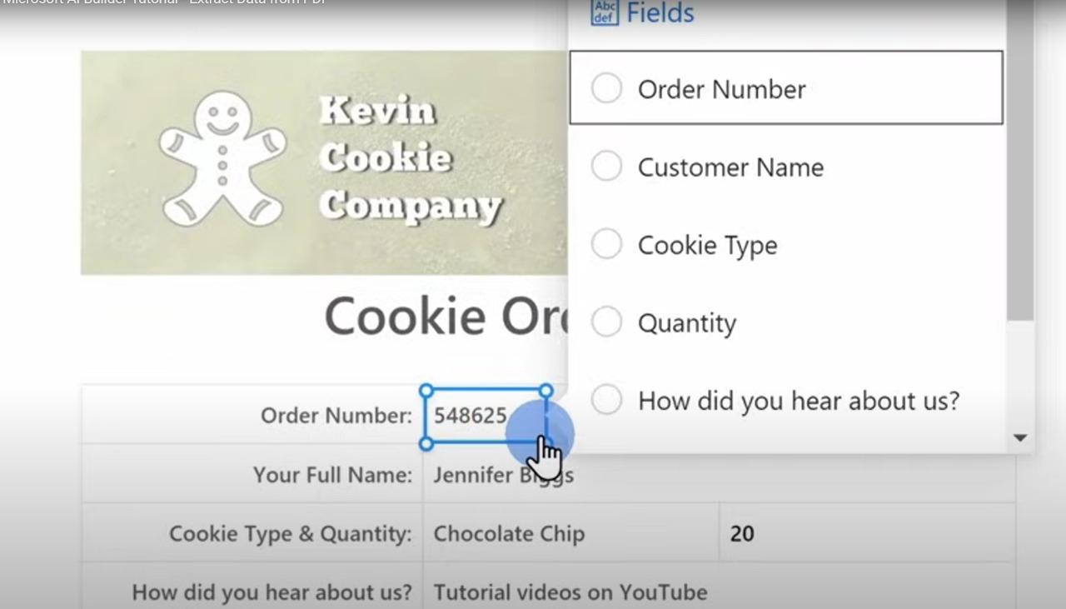
After uploading the docs. We will now be training the app to extract the needed data. Open the document and select the items in the document to be extracted and choose the type of field that you have added in the beginning for the selected item.

Slide 24
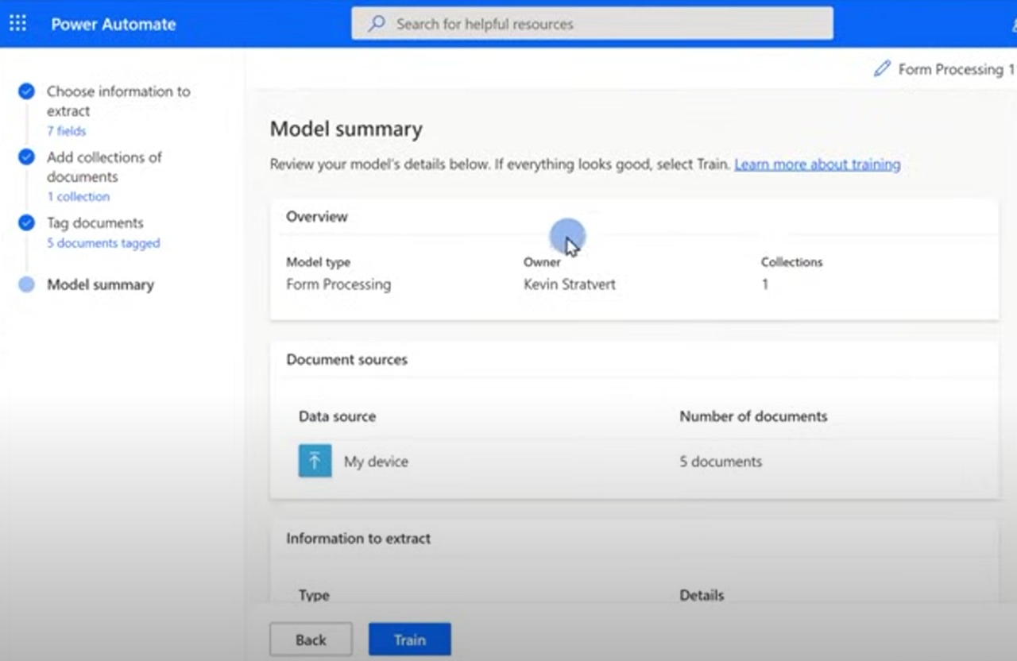
We have finished tagging the documents and specifying the items in document. There will be a model summary that shows from the beginning process where you have chosen the info extract till tagging the docs, you can add or edit any changes in here.

Slide 25
Now it’s time to actually train the AI Model. After you are done with editing any changes. Press “Train”.

Slide 26
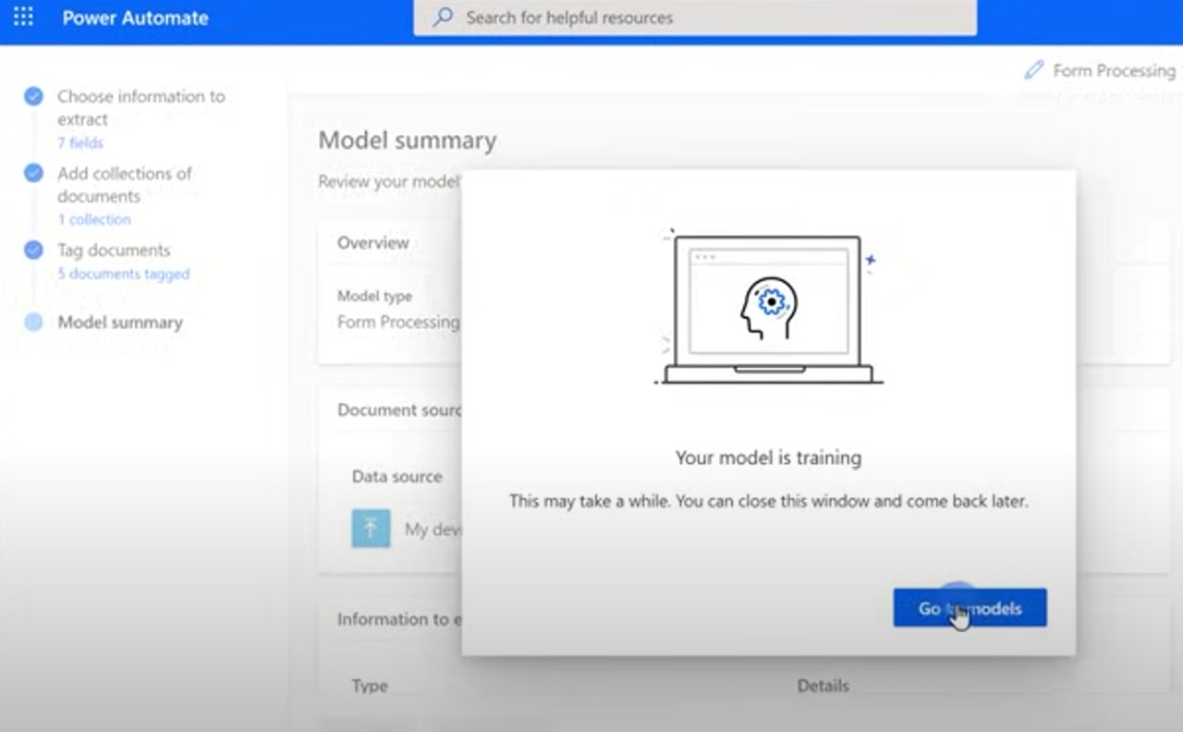
The AI Model is in the training process.

Slide 27
Press “Go to Models”

Slide 28
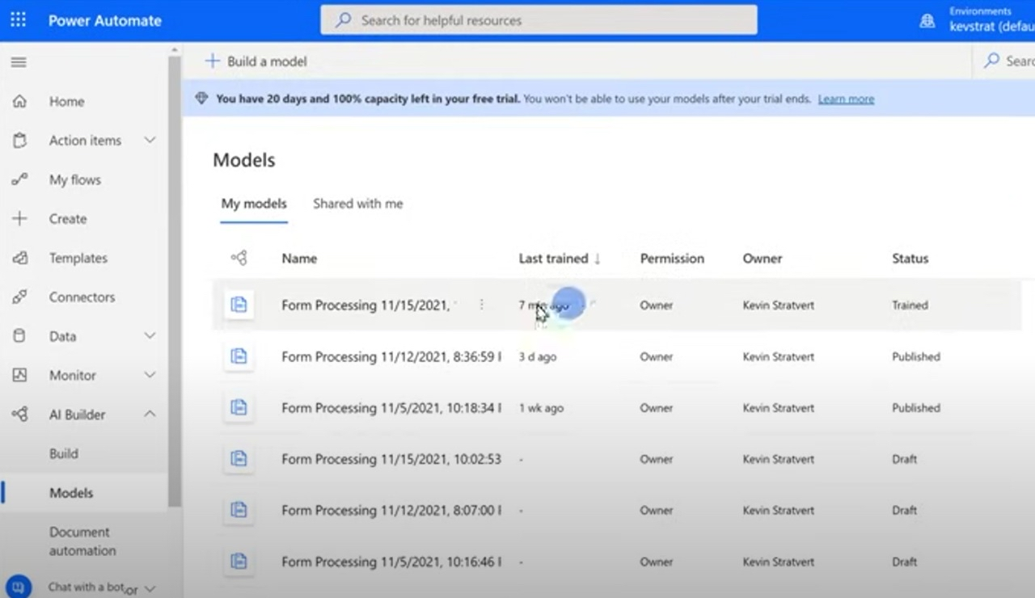
You will see all the docs that have been uploaded, published and trained.

Slide 29
Press the document that you have just trained.

Slide 30
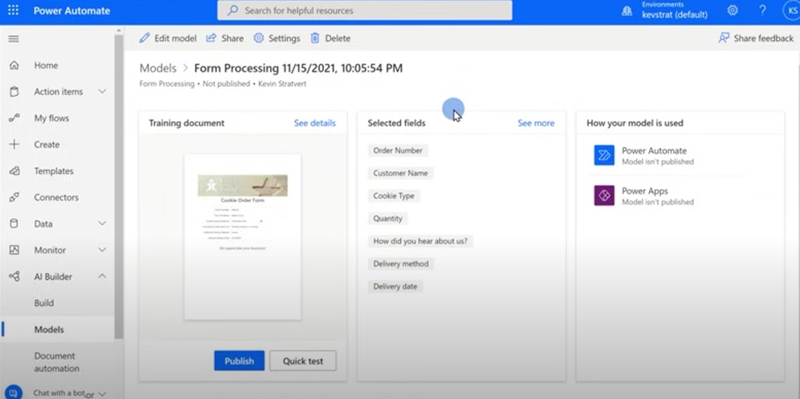
You can do a quick test before publishing the AI Model in Power Automate or Power Apps

Slide 31
If you are going to publish the AI Model. Press “Publish”

Slide 32
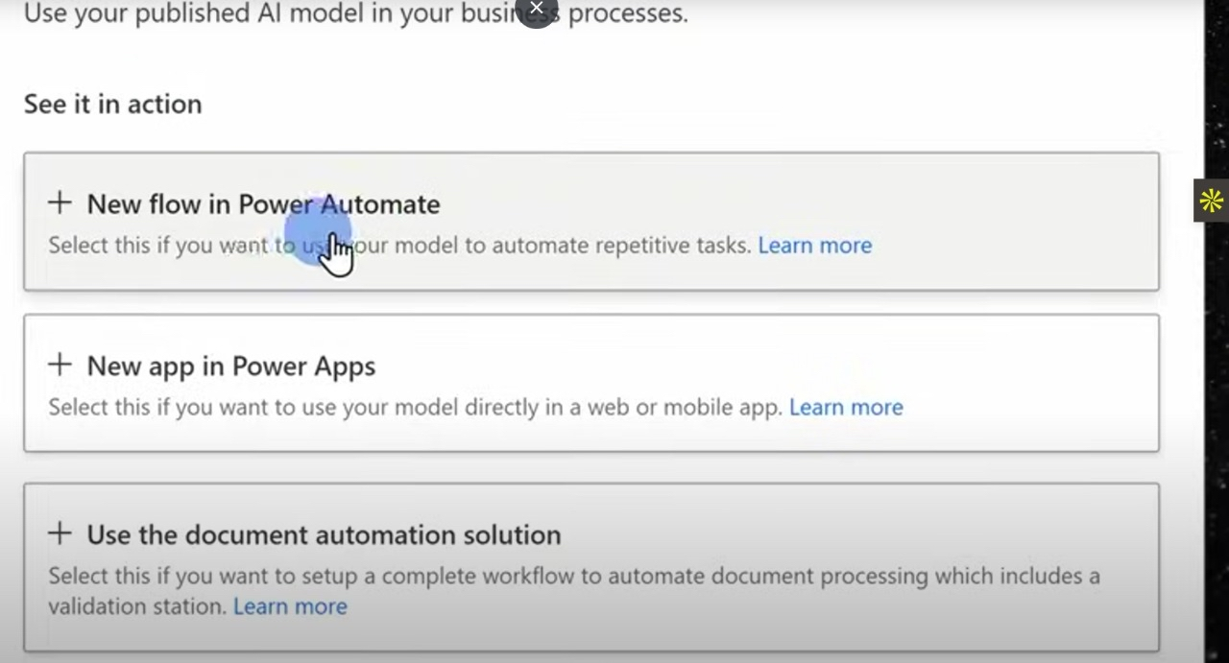
You can use your published AI Model in other processes. In our case. We will use the published AI Model in power apps as we would want to connect it to the interface (Validation App).

Slide 33
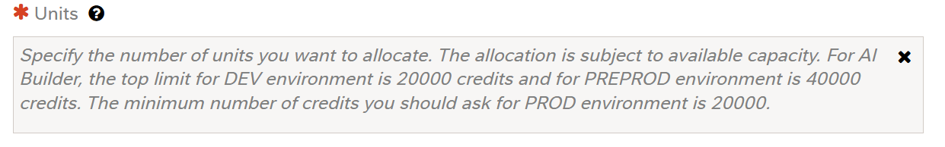
Estimated cost & time for implementation
- The app will be in the testing phase and is expected to be fully developed within 2 weeks to a month.
- For each environment. There are maximum number of AI Builder credits you can request.
- If the request has been accepted. 20,000 credits will be allocated and for training the AI model. It would be sufficient for a 2-page document.
Prediction per document: ~1–5 credits per run.
Training a model: ~500–1,000 credits depending on complexity.

Slide 34
Thank you

